Slide 1
Thematic Unit Presentation
Jodi Ide
Brighton High School
AP European History

Slide 2
Thematic Unit
Learning Goal: Students will be able to understand the requirements of document-based essay questions for the AP European History test and be able to write document‐based essays.
Students will use math and science skills in order to interpret charts and graphs, social studies for background information on the essay topic, and language arts skills in writing the essay.

Slide 3
A – Learner Analysis
Most of the students in the class are 15 – 16 years old.
85% of students understand essays, but they are not happy about writing them.
5% don’t understand how to write essays and 10% of them understand essays and enjoy writing them.
90% of my students are in Honors English.
58% of my students have written a document based essay question before.
When asked what the first word that comes to mind is when you see the word document based essay question most students chose a word or phrase that was negative.

Slide 4
A – Task Analysis
Core Skills | Expanded Core Points
Provides a clearly stated and appropriate thesis that addresses all parts of the question. Thesis should not merely be a restating of the question. | Having a clear, analytical, and comprehensive thesis.
Discusses a majority of the documents individually and specifically. | Using every document or almost every document.
Demonstrates an understanding of the basic meaning of the documents (you may misinterpret no more than one document). | Discussing bias or point of view in at least four documents.
Supports thesis with an appropriate interpretation of the majority of the documents. | Analyzing documents by creating additional groupings or using some other advanced method
Shows point of view or bias in at least three documents. | Using outside information
Analyzes documents by organizing them into at least three appropriate groups. | Displaying an understanding of the nuances within the document.
 | Addresses all parts of the question thoroughly
 | Uses documents persuasively as evidence.

Slide 5
A – Needs Analysis
 | No Idea |  | Somewhat of an Idea |  | An Idea |  | Confident
 | Before | After | Before | After | Before | After | Before | After
Thesis Statement | 1.5% |  | 13.6% |  | 37.9% |  | 47%
Topic Sentence | 0% |  | 10.6% |  | 41.5% |  | 47.7%
Grouping of Documents | 19.7% |  | 42.4% |  | 25.5% |  | 12.1%
Attrition of Documents | 62.1% |  | 22.7% |  | 6.1% |  | 9.1%
Analysis of Documents | 7.5% |  | 21.2% |  | 51.5% |  | 19.7%
Point of View or Bias of Documents | 4.5% |  | 25.8% |  | 45.5% |  | 24.2%
Tone within a Document | 13.6% |  | 25.8% |  | 28.8% |  | 31.8%
Citing Documents within Essay | 6.1% |  | 25.8% |  | 28.8% |  | 31.8%
Reliability of a Document | 12.1% |  | 19.7% |  | 47% |  | 21.2%

Slide 6
D - Design
Objectives:
Students will be able to label the core requirements of document-based essay questions with 100% accuracy.
Students will be able to demonstrate an understanding of the basic meaning of each document by summarizing them into three appropriate groupings on the essay question topic.
Student will be able to demonstrate point of view or bias in 9 of the document by identifying the point of view of a document, tone of a document, or reliability of a document.
Students will be able to use attrition correctly when citing documents.
Students will be able to write a document-based essay satisfying the core requirements of a document-based essay in AP European History.

Slide 7
D - Development
Scope and Sequence – five days
Facilitator Instructions
Student Instructions
Sample of handouts and activities

Slide 8
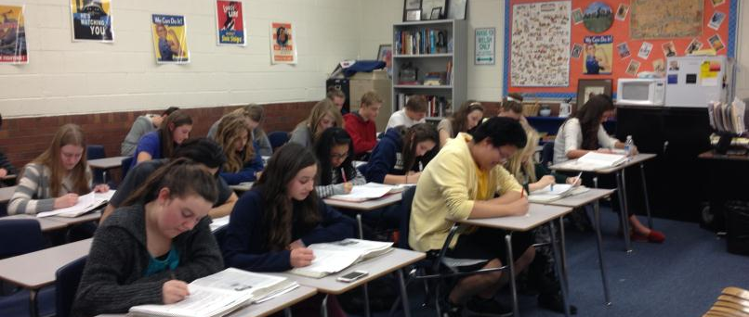
I - Implementation

Slide 9
Evaluation – Learner Reaction
Was the document- based essay rubric (bright green) helpful in your understanding of document-based essay questions? 98.2 % said yes to this question.
Was grading and labeling the sample essay an effective tool in helping you understand document-based essay questions? 92.9% said yes to this question.
Was it helpful to go over the documents together as a class before you put them into groups with your seat partner? 96.4 % said yes to this question.
Was it helpful working with your seat partner when asked to group documents and to identify POV or bias? 83.9% said yes to this question.
Was it helpful to write the thesis statement and two body paragraphs together as a class? 91.1 % said yes to this question.
Do you feel that your understanding of document-based essay questions has improved since last week? 98.2 % said yes to this question.

Slide 10
Evaluation – Meeting Objectives
 | No Idea |  | Somewhat of an Idea |  | An Idea |  | Confident
 | Before | After | Before | After | Before | After | Before | After
Thesis Statement | 1.5% | 0% | 13.6% | 3.6% | 37.9% | 25% | 47% | 71.4%
Topic Sentence | 0% | 0% | 10.6% | 5.4% | 41.5% | 32.1% | 47.7% | 62.5%
Grouping of Documents | 19.7% | 0% | 42.4% | 8.9% | 25.5% | 51.8% | 12.1% | 39.3%
Attrition of Documents | 62.1% | 5.4% | 22.7% | 12.5% | 6.1% | 35.7% | 9.1% | 46.4%
Analysis of Documents | 7.5% | 0% | 21.2% | 21.2% | 51.5% | 42.9% | 19.7% | 44.6%
Point of View or Bias of Documents | 4.5% | 0% | 25.8% | 7.1% | 45.5% | 50% | 24.2% | 42.9%
Tone within a Document | 13.6% | 1.8% | 25.8% | 28.6% | 28.8% | 42.9% | 31.8% | 26.8%
Citing Documents within Essay | 6.1% | 0% | 25.8% | 1.8% | 28.8% | 17.9% | 31.8% | 80.4%
Reliability of a Document | 12.1% | 0% | 19.7% | 8.9% | 47% | 41.1% | 21.2% | 50%

Slide 11
Evaluation
Facilitator Evaluation
Materials/Technology
Environment
Continuity & Conformity
Design timing needed to be changed.

Slide 12
Final Thoughts
My objectives were met!
Students need additional practice – especially with tone within a document.
I need to adjust my timing in my design document.
The ADDIE model works!

